Slide 1
Tasks and Level of Effort
Software Engineering
Neil Toporski

Slide 2
1 Tasks and Level of Effort
Breaking Down the User Story
Estimating Task Effort
Breaking Down User Stories
When is it “Done?”

Slide 3
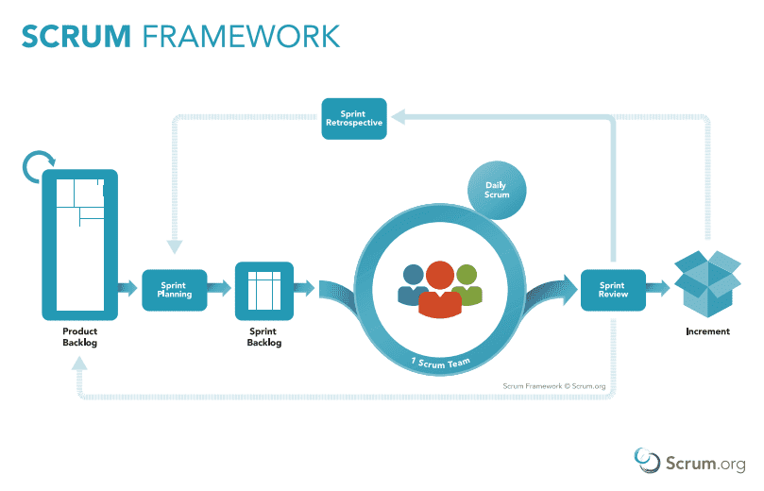
1.1 Breaking Down the User Story: Sprint Planning
Notes:
As a team, which from product backlog → sprint backlog

Slide 4
Breaking Down the User Story: Sprint Planning
All the work that is to be performed in a Sprint is planned at the Sprint Planning.
About 2 hours per week
The Plan is created by the team.
The Scrum Master ensures that the team understands the Sprint and potential deliverables.
Sprint planning answers the following:
What can be delivered in the Increment resulting from the upcoming Sprint? (is it doable?)
How will the work needed to deliver the Increment be achieved?

Slide 5

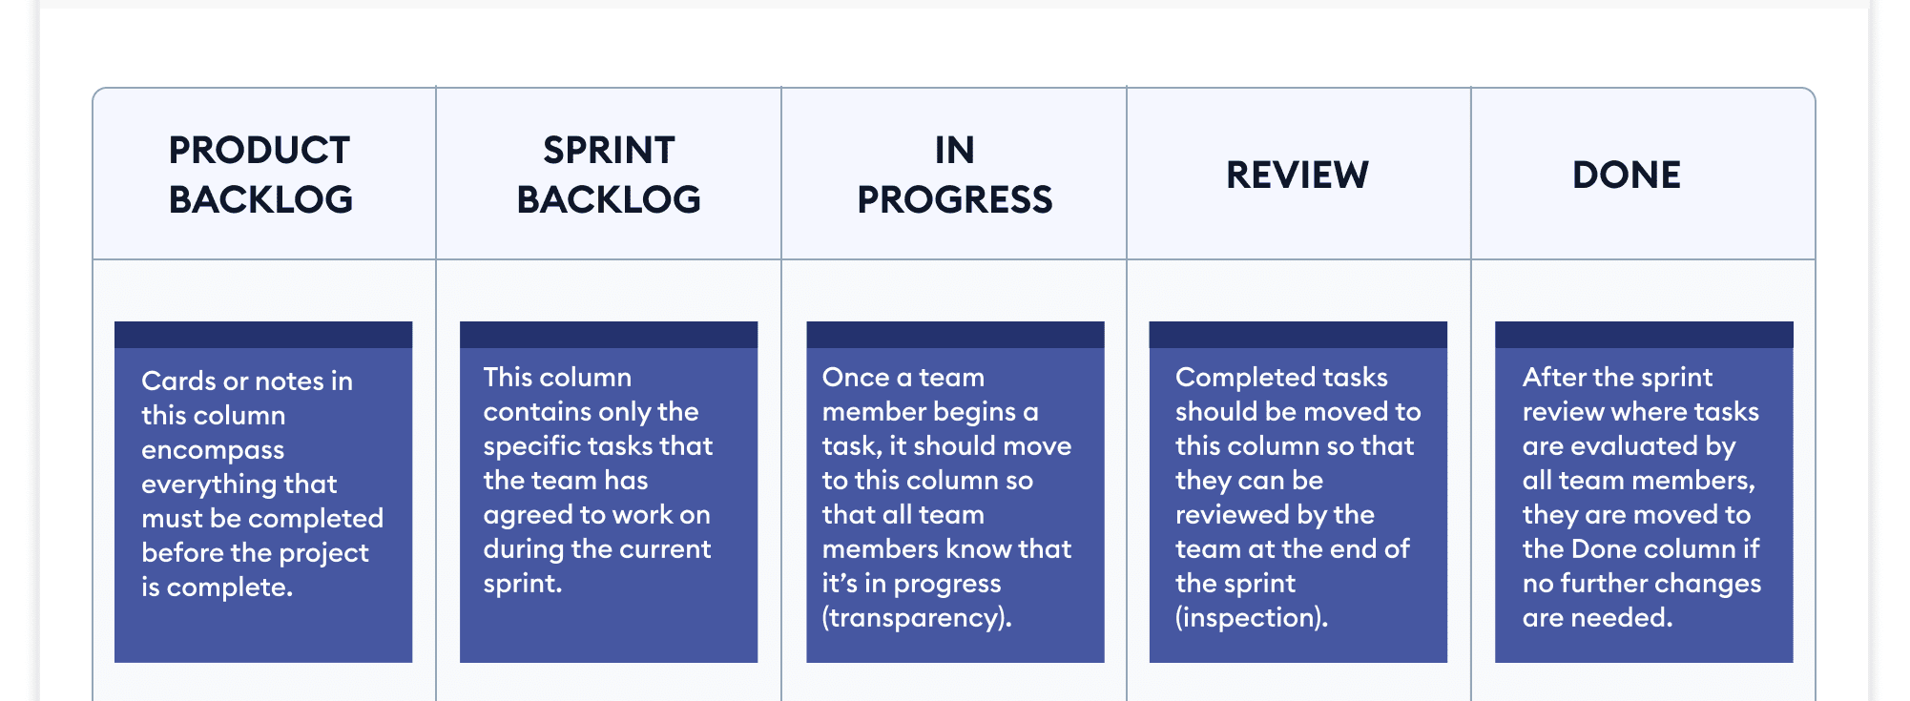
Breaking Down the User Story: Sprint Planning

Slide 6
Breaking Down the User Story: Common Problems with Sprint Planning
PO dictates and deciding what work will be completed
The product backlog is not healthy, prioritized or ready to be discussed
No one understands what is actually meant by done.
The meeting is too long
The meeting is too short
The meeting is not engaging
Some people do not have a voice or do not participate
Poor environment and team members do not feel support or safe
The team does not actually understand why they do this meeting
Notes:
First increment → what are we going to have at the end of this sprint? What are we going to call done here? (goal)

Slide 7
1.2 Estimating Task Effort
A task is a piece of activity/action that is required to get a story done
Describe the tasks in such a way that they convey the actual intent.
While the product owner is responsible for prioritizing the backlog and capturing requirements from the business and the users …
the team developers are really the ones best positioned to understand what in terms of technical capabilities must be developed, as well as the level of effort entailed.

Slide 8
Estimating Task Effort
Keep the tasks concise but detailed
Create tasks that are “right-sized”
Tasks should not take more than one day to program/code
The team is able to inspect and adapt daily
That being said, there's no "rule" that tasks must be time-boxed
A task should be completed by one person on the team

Slide 9
Estimating Task Effort
Estimate “effort” for each task
If “effort” = “hard” can you break it down further?
Are the acceptance criteria met upon execution of all the tasks?
Does the cumulation of all tasks meet the definition of “Done” for that Sprint?

Slide 10
1.3 Breaking Down User Stories
Start with concise user story
As a developer <some goal> I want to be able to add text into the Scenario <for some reason> so that USERS can view the Scenario Story
Break down user story into respective acceptance criteria
Text can be entered/edited/deleted in a text field
Create the task
In the system programming environment (Web), create a textbox (using Javascript)

Slide 11
Breaking Down User Stories
Create the task
In the system programming environment (Web), create a textbox using Javascript.
”Program/code” the task:
<!doctype html> <html lang= "en"> <body> <script> const input = document.createElement("input"); input.setAttribute("id", "username"); input.setAttribute("type", "text"); document.body.appendChild(input); const label = document.createElement("label"); label.setAttribute("for", "username"); label.innerHTML = "Scenario: "; const usernameText = document.getElementById("username"); document.body.insertBefore(label, usernameText);</script> </body></html>

Slide 12
Breaking Down User Stories
Does the code meet the expectations?
In the system programming environment (Web), create a textbox using Javascript.
In the system programming environment (Web), create a textbox using Javascript where the user can input more than one line of text.
<!doctype html> <html lang= "en"> <head> <meta charset= "utf-8"> <title>Expand textarea </title> <style> textarea{overflow-y:scroll} </style> <script> onload=function(){ var who=document.getElementsByName('comments')[0]; who.onkeyup=function(){ if(who.scrollTop)who.rows=parseInt(who.rows)+5; } } </script> </head> <body> <textarea name=”Scenario" cols="50" rows="5"></textarea> </body> </html>
Notes:
Break down into non-functional requirements
(make it fit better to our needs/expectations)
At least you got something accomplished

Slide 13
1.4 When is it “Done?”
When all the tasks in the Sprint Backlog are completed
Create a checklist template for your definition of Done
When to Code is reviewed/refactored
Get rid of any “switch” statements
Make your conditionals descriptive
Avoid code duplication
Functions should only do one thing
Code is “clean” and commented throughout
Code is reviewed
When the increment is tested
Does it work?
Are there any bugs/errors/defects?
It’s approved by the product owner/client
Notes:
Switch statements susceptible to errors

